Slide 1
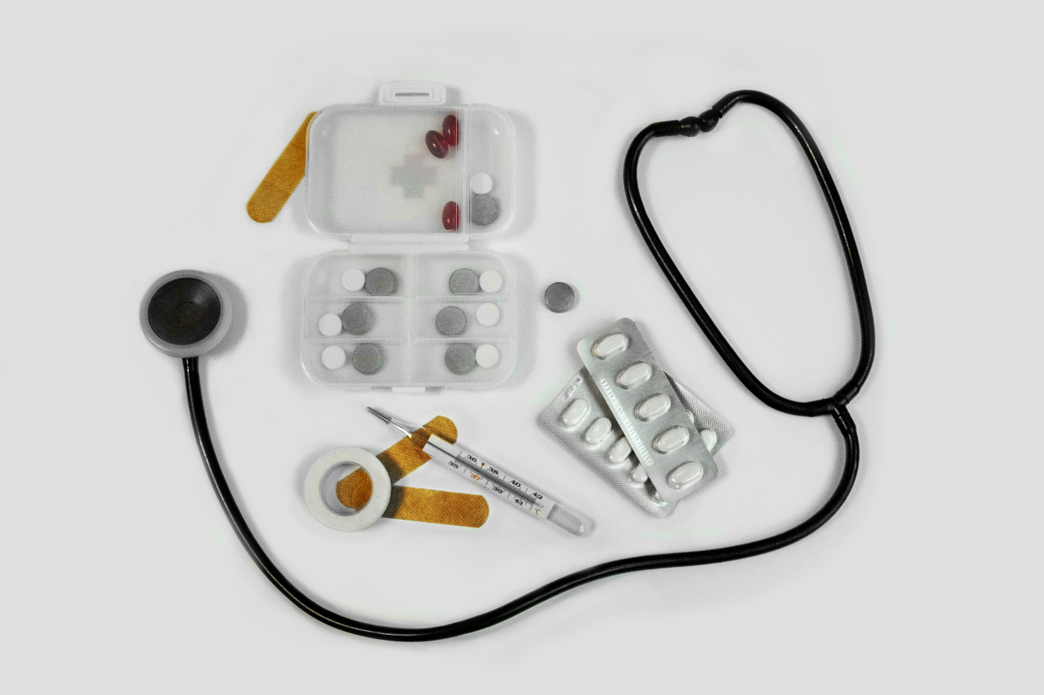


Medical Inventory Optimization

Slide 2
Contents
Business Objective
Business Constraints
Project Architecture - Data Flow Diagram
Data Collection
Exploratory Data Analysis
Data Visualization

Slide 3
Business Problem
Business Problem: Bounce rate is increasing significantly leading to patient dissatisfaction.
Business Objective: Minimize bounce rate.
Business Constraint: Minimize inventory cost.
Success Criteria:
Business Success Criteria: Reduce bounce rate by at least 30%.
Economic Success Criteria: Increase revenue by at least 20 laccs INR by reducing bounce rate.

Slide 4
Project overview And Scope
Project Overview:
The project aims to address the increasing bounce rate at the medical shop, which is leading to patient dissatisfaction. The primary objective is to minimize the bounce rate while also ensuring that the inventory costs are kept low.
Scope:
The scope of this project is to develop and implement a medical inventory optimization model specifically for the pharmacy department of the leading hospital in India. The model will focus on improving inventory management practices to reduce bounce rates and minimize inventory costs.

Slide 5
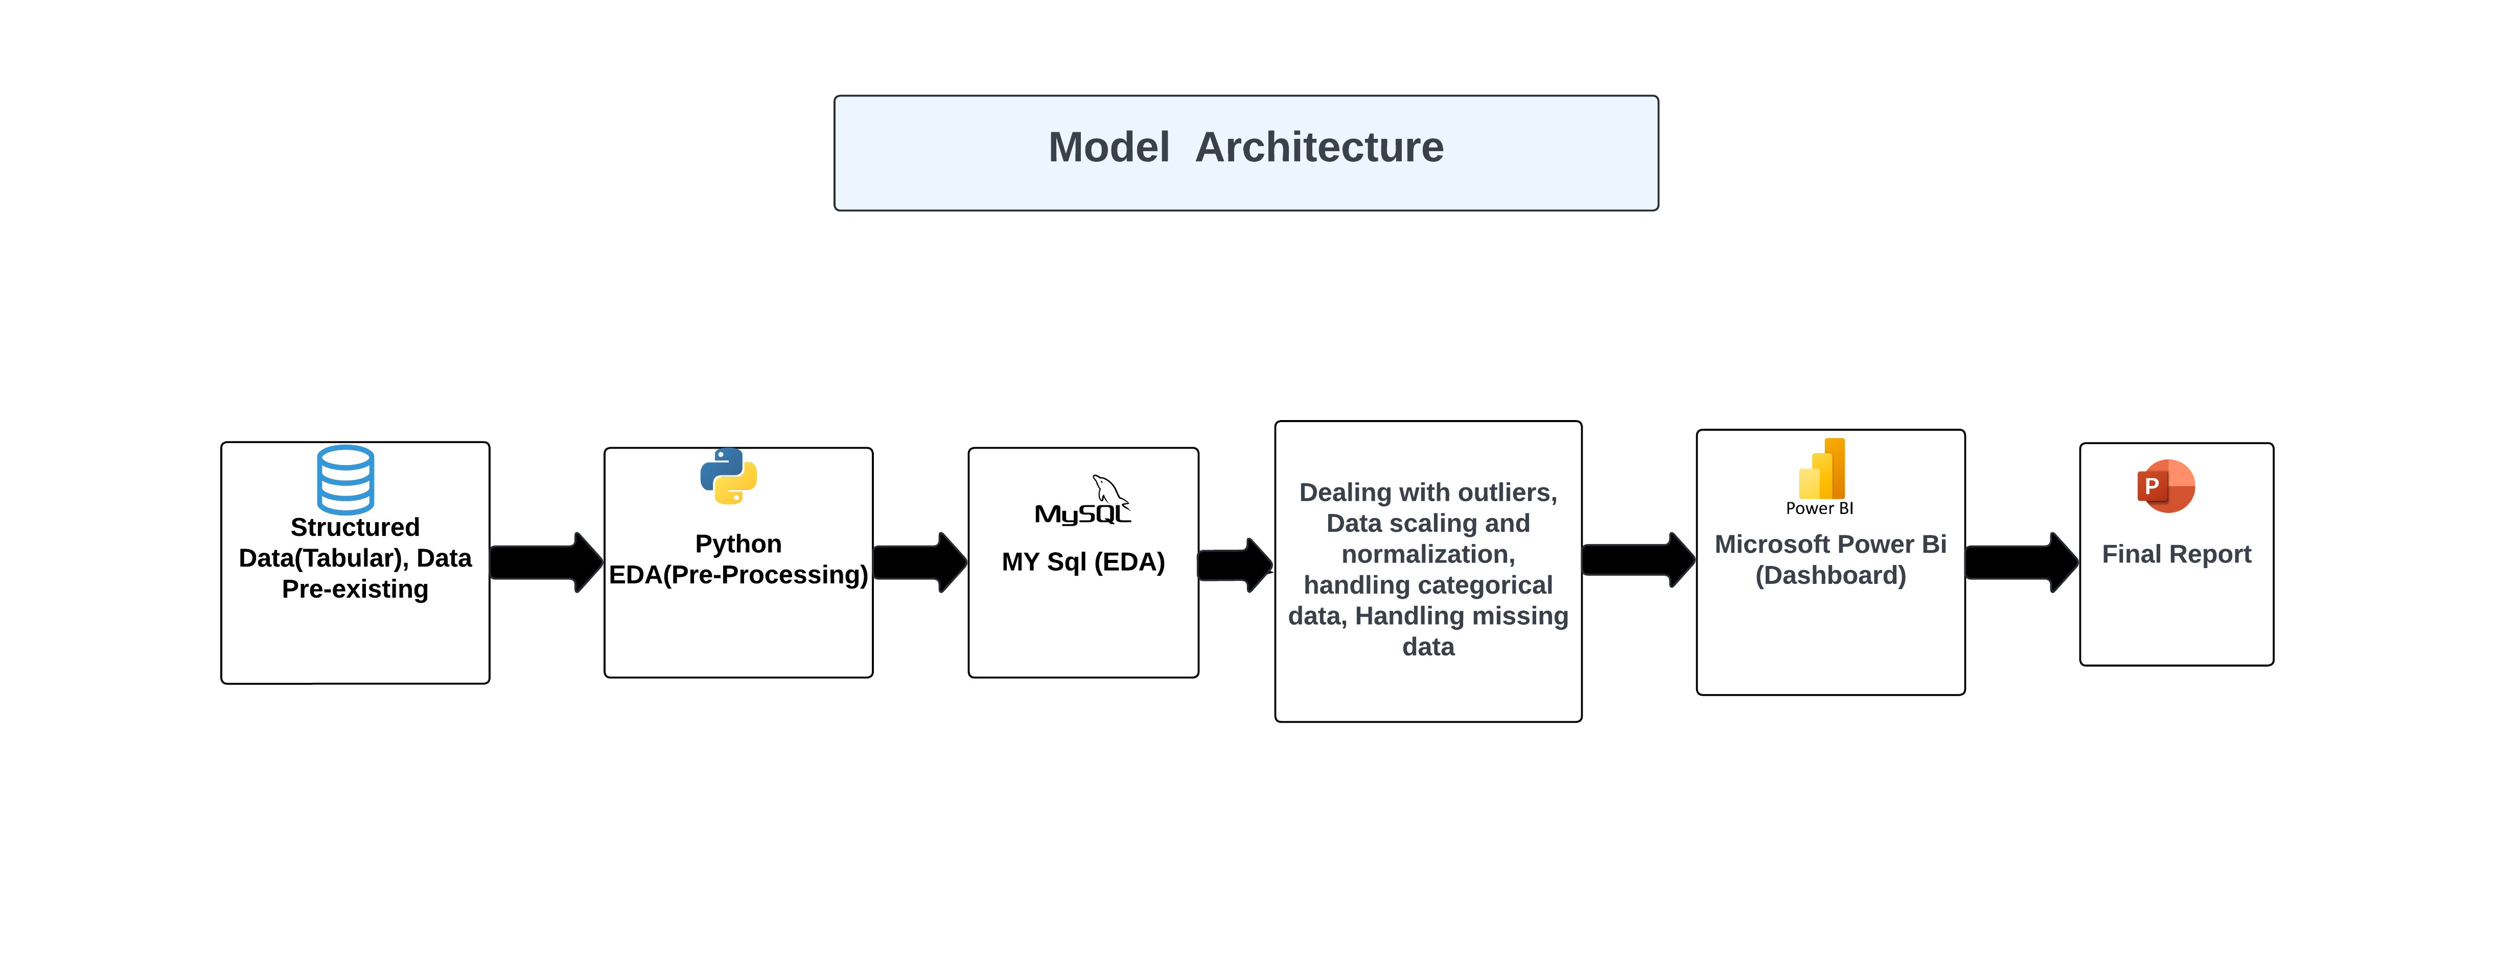
Project Architecture

Slide 6
Data Dictionary
Variable Name | Variable Description
BillDate | Date of the bill generated
TQty | Total quantity of medicines in inventory
UCPwithoutGST | Uniform Customs and Practice without GST
PureGSTPer | Pure percentage of GST
MRP | Maximum Retail Price of medicines in inventory
TotalCost | Factory total cost after adding GST percentage
TotalDiscount | Total discount applied for product
NetSales | Total sum of sales after selling the number of products
GenericName | Generic name of drugs
SubCategory | Types of drug in category like, injections, tablets and capsules and IV FLUIDS, ELECTROLYTES, TPN
SubCategoryL3 | The problem of cause for patients for which certain drug is used
AnonymizedBillNo | Anonymized bill number of drugs
AnonymizedSpecialisation | Anonymized specialization of drugs
ReturnMRP | Return MRP of drugs
The type of data collection for the Medical Inventory Optimization Dataset is secondary data collection.
The Shape of Dataset (85001 rows, 14 columns)

Slide 7
Exploratory Data Analysis [EDA]
Data Pre-Processing
Typecasting
First Moment of Business Decision/ Measures of Central Tendency
Second Moment of Business Decision/ Measures Dispersion
Third Moment of Business Decision/ Skewness
Fourth Moment of Business Decision/ Kurtosis
Finding outliers
Finding Insights through visualization
Notes:
EDA is used for seeing what the data can tell us before the modeling task.
Change

Slide 8
Exploratory Data Analysis [EDA]
column name | Data type | Mean | Median | Mode | Range | variance | standard Deviation | skewness | kurtosis
Returned | int64 | -0.28852 | 0 | 0 | 378 | 2.9405 | 1.7148 | -129.04785 | 27745.77
Quantity | int64 | 2.003282 | 1 | 1 | 120 | 6.2612 | 2.5022 | 8.8096 | 197.092
TotalCost | float64 | 538.6967 | 77.28 | 10.92 | 121054.5 | 4531544.1 | 2128.742 | 14.1812 | 376.7646
NetSales | float64 | 963.8482 | 99.4 | 0 | 100620 | 10255711 | 3202.4539 | 8.9836 | 145.6483
ReturnMRP | float64 | 116.0616 | 0 | 0 | 160801.2 | 1211865.5 | 1100.8476 | 48.25126 | 5617.403
Before finding Outliers
column name | Data type | Mean | Median | Mode | Range | variance | standard Deviation | skewness | kurtosis
Returned | int64 | 0.0 | 0 | 0 | 0 | 0 | 0 | 0.0 | 0.0
Quantity | int64 | 1.64 | 1 | 1 | 3.5 | 1.20 | 1.09 | 0.34 | -0.93
TotalCost | float64 | 170.92 | 77.28 | 584.62 | 584.64 | 39290.81 | 198.21 | 1.20 | -0.04
NetSales | float64 | 304.57 | 99.4 | 1104.97 | 155509.86 | 394.34 | 3202.4539 | 1.20 | -0.14
ReturnMRP | float64 | 0 | 0 | 0 | 0.0 | 0.0 | 0.0 | 0.0 | 0.0
After finding Outliers
Notes:
EDA is used for seeing what the data can tell us before the modeling task.
Change

Slide 9
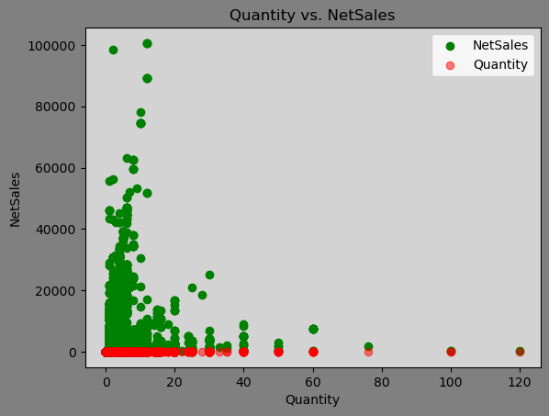
Data Visualization
This suggests that the majority of transactions involve low quantities.
As the quantity increases beyond 20, the Net Sales tend to decrease, with some outliers.
There are very few high-quantity transactions, and those that do exist generally have lower Net Sales compared to the low-quantity, high-sales cluster.
Notes:
Add graphical

Slide 10
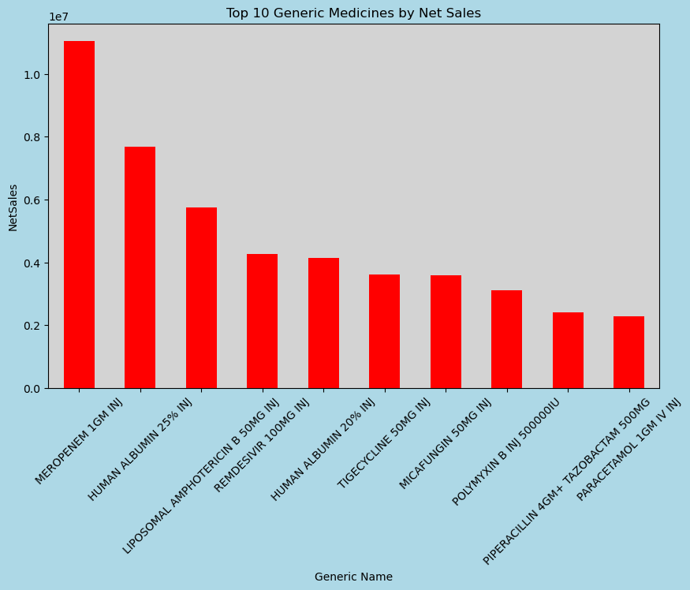
Data Visualization
Discontinue or phase out products with consistently low or zero sales unless there's a strategic reason to keep them.
Conduct market research to understand the reasons behind the zero sales. Like ALTEPLASE 20MG
Price Sensitivity: The high net sales might be a result of high unit prices rather than just volume.
Notes:
Add graphical

Slide 11
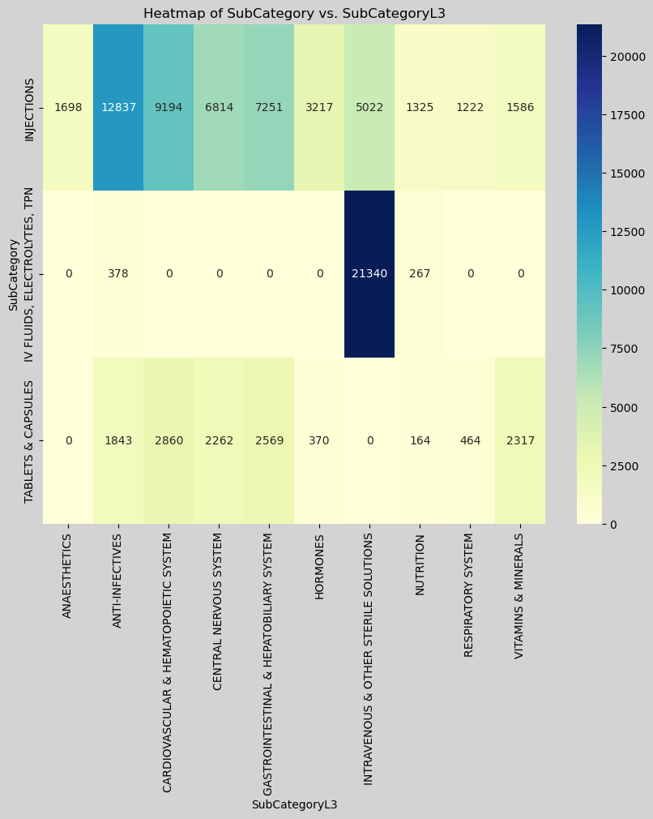
Data Visualization
INJECTIONS: shows a wide distribution across multiple subcategory.
IV FLUIDS, ELECTROLYTES, TPN: The most significant concentration is in INTRAVENOUS & OTHER STERILE SOLUTIONS (21340), indicating a specialization or focus in this area.
TABLETS & CAPSULES: This subcategory is more evenly distributed across multiple SubCategoryL3 entries, but with lower overall values compared to INJECTIONS.
Notes:
Add graphical

Slide 12
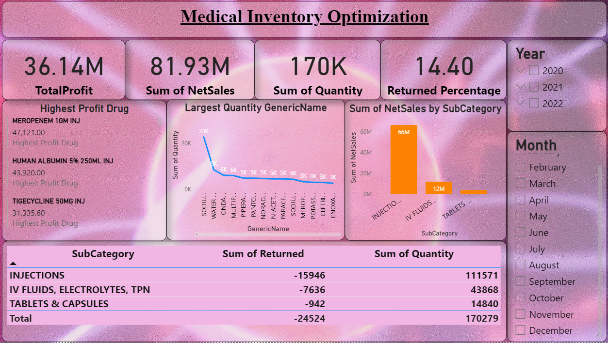
Data Visualization
Notes:
Add graphical

Slide 13
Business Insights
Strengthen the supply chain, marketing, and availability of top-performing drugs like MEROPENEM 1GM INJ and HUMAN ALBUMIN to maintain and potentially increase their market share.
Many of the top-selling medications such as REMDESIVIR 100MG INJ, HUMAN ALBUMIN 20% INJ, and TIGECYCLINE 50MG INJ are often used in critical care, suggesting a significant market demand for life-saving or essential hospital medications.
Discontinue or phase out products with consistently low or zero sales unless there's a strategic reason to keep them.
Conduct market research to understand the reasons behind the zero sales. Like ALTEPLASE 20MG

Slide 14
Business Insights
High-Cost, High-Use Products:
Products with high total costs are typically those used in critical care or for treating severe conditions, justifying their high prices and significant use.
Low-Cost, Low-Use Products:
These are often essential but less expensive medications, possibly older drugs or those that are used in less severe cases or as part of combination therapies.
Specialty vs. General Medications:
High sales figures are often seen in specialized medications for severe or complex conditions (e.g., severe infections, critical care solutions), while general medications for common conditions often have lower sales figures.
Economic Implications:
The data indicates that high-cost drugs have substantial sales, emphasizing the economic burden on healthcare systems, while low-cost drugs have minimal financial impact despite their essential nature.

Slide 15


